Slide 1
Simplification of Logic Functions Using SOP, POS
Lecture 4
Prepared by : Eng.Amani Safwat

Slide 2
Introduction to Logic Simplification
Logic simplification is the process of reducing a complex logical expression to its simplest form without changing its output. The goals of simplification are:
Reduce the number of gates and logic used in circuits.
Save cost and power.
Make the design easier to understand and maintain

Slide 3
SOP
SOP (sum of product)
Each term is a product (AND) of variables or their complements.
Then all terms are summed together using OR.
SOP is widely used because it is easy to convert into a logic circuit using AND and OR gates.
Y=A′B+AB′
Each term like A′B is a product.
All terms are summed using + (OR)

Slide 4
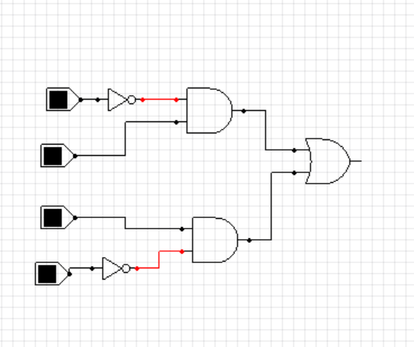
SOP
Y=A′B+AB′

Slide 5
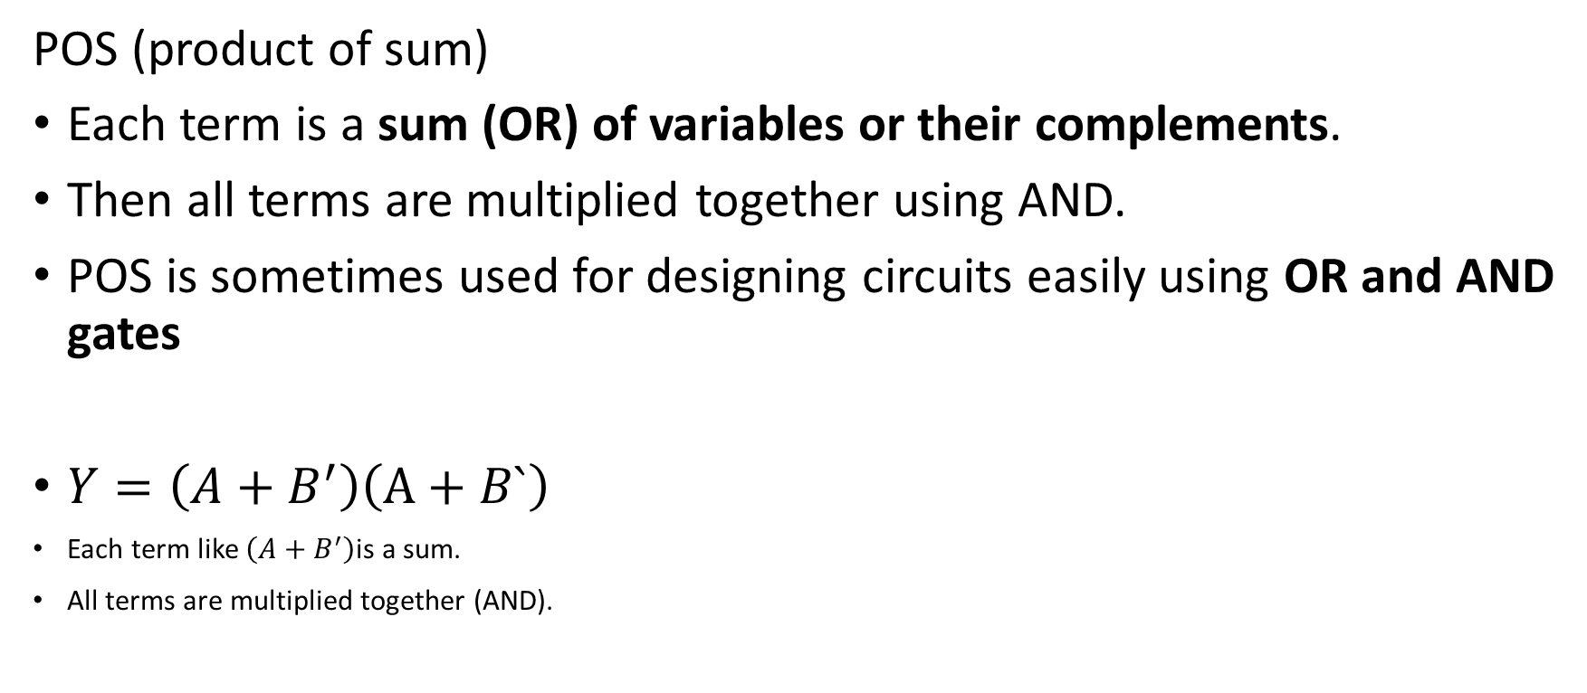
POS
POS (product of sum)
Each term is a sum (OR) of variables or their complements.
Then all terms are multiplied together using AND.
POS is sometimes used for designing circuits easily using OR and AND gates
$Y=\left(A+B^{′}\right)\left(A+B`\right)$
Each term like $\left(A+B^{′}\right)$is a sum.
All terms are multiplied together (AND).

Slide 6
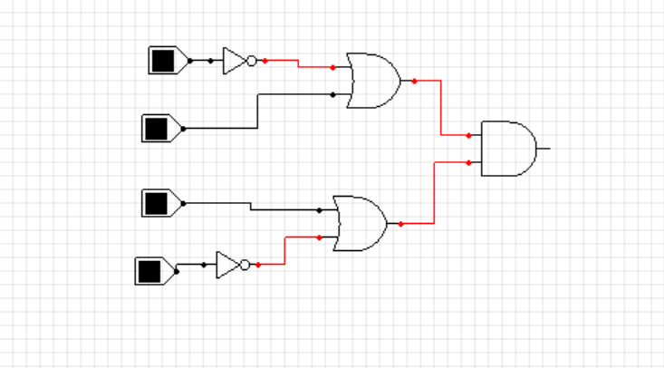
POS
Y=(A`+B).(A+B`)

Slide 7
Canonical SOP
F _{(A,B)} = Σ (1,3)
Canonical SOP is the sum of all minterms that give output 1.
Each minterm is the AND of all variables, complemented or not.
Called canonical because it represents the function exactly, without simplificationIf
the function Y = (A, B) is equal to:
(A, B) = (0, 1), (1, 0)
The standard SOP formula is:
Y = A`B+AB`

Slide 8
Canonical POS
F _{(A,B)} = Π (0,2)
Canonical POS is the product of all maxterms that give output 0.
Each maxterm is the OR of all variables, complemented or not, depending on value.
Called canonical because it represents the function exactly before any simplification
the function Y = (A, B) is equal to:
(A, B) = (1, 1), (1, 0)
The standard POS formula is:
Y = (A`+B.(A`+B)

Slide 9
Example
From this table find :
1.SOP
2.POS
3.Canonical SOP
4. Canonical POS
A | B | C | F
0 | 0 | 0 | 0
0 | 0 | 1 | 1
0 | 1 | 0 | 0
0 | 1 | 1 | 1
1 | 0 | 0 | 1
1 | 0 | 1 | 0
1 | 1 | 0 | 1
1 | 1 | 1 | 0

Slide 10
Example
To find SOP :
We look at the number of one in the result, write the number of variables, and then add negation to the input whose value is zero.
F = A`B`C+A`BC+AB`C`+ABC`
A | B | C | F
0 | 0 | 0 | 0
0 | 0 | 1 | 1
0 | 1 | 0 | 0
0 | 1 | 1 | 1
1 | 0 | 0 | 1
1 | 0 | 1 | 0
1 | 1 | 0 | 1
1 | 1 | 1 | 0

Slide 11
Example
To find POS :
We look at the zero in the result, write down the number of variables, and then add the negative to the input whose value is one.
F =)A+B+C).(A+B`+C).(A`+B+C`).(A`+B`+C`)
A | B | C | F
0 | 0 | 0 | 0
0 | 0 | 1 | 1
0 | 1 | 0 | 0
0 | 1 | 1 | 1
1 | 0 | 0 | 1
1 | 0 | 1 | 0
1 | 1 | 0 | 1
1 | 1 | 1 | 0

Slide 12
Example
Canonical SOP:
0 0 1 0 1 1 1 0 0 1 1 0
F _{(A,B,C) =} Σ(1,3,4,6)
A | B | C | F
0 | 0 | 0 | 0
0 | 0 | 1 | 1
0 | 1 | 0 | 0
0 | 1 | 1 | 1
1 | 0 | 0 | 1
1 | 0 | 1 | 0
1 | 1 | 0 | 1
1 | 1 | 1 | 0
1
3
4
6

Slide 13
Example
Canonical POS
0 0 0 0 1 0 1 01 1 1 1
F _{(A,B,C) =} Π(0,2,5,7)
A | B | C | F
0 | 0 | 0 | 0
0 | 0 | 1 | 1
0 | 1 | 0 | 0
0 | 1 | 1 | 1
1 | 0 | 0 | 1
1 | 0 | 1 | 0
1 | 1 | 0 | 1
1 | 1 | 1 | 0
0
2
5
7

